Slide 1

Data Description
Session 7
M. Kachour

Slide 2
Dispersion indicators
A numerical indicator is said to be dispersion if it is a key number used to measure the variability of observations in a statistical series.
A dispersion indicator is always positive (the higher its value, the more observations are "spread" around a central position indicator (the mean or median))

Slide 3
Note

Slide 4
Dispersion indicators
We will study the following indicators:
Variance and standard deviation
The coefficient of variation
The range
The interquartile range
The relative interquartile coefficient
Indicators associated with data from a quantitative variable only

Slide 5
Note

Slide 6
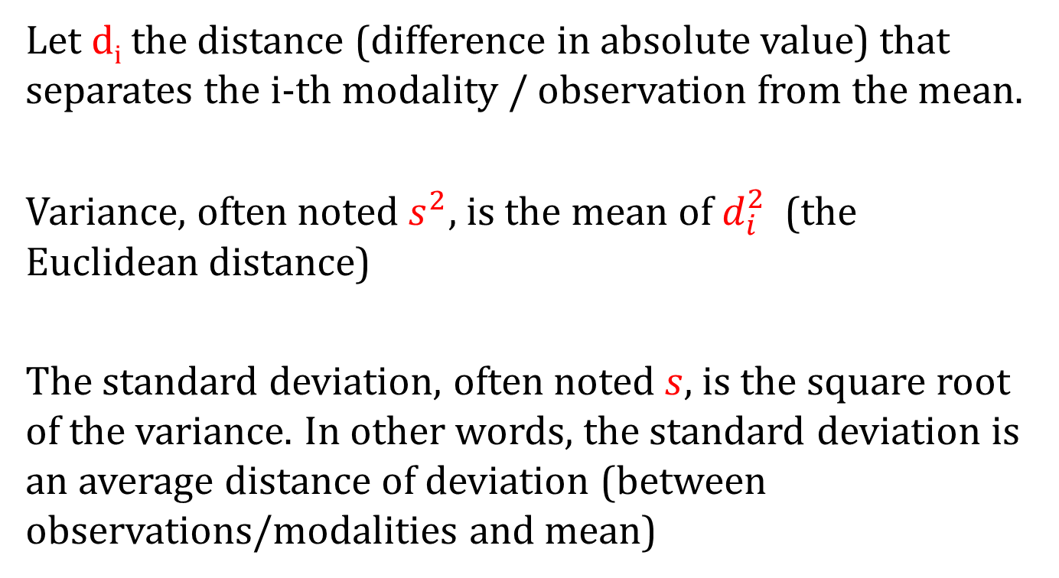
Dispersion Indicators –
Variance and Standard Deviation
Let d_{i} the distance (difference in absolute value) that separates the i-th modality / observation from the mean.
Variance, often noted $s^{2}$, is the mean of $d_{i}^{2}$ (the Euclidean distance)
The standard deviation, often noted $s$, is the square root of the variance. In other words, the standard deviation is an average distance of deviation (between observations/modalities and mean)

Slide 7
Note

Slide 8
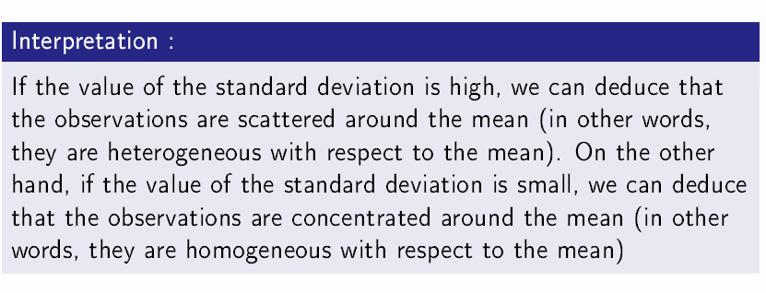
Dispersion Indicators –
Variance and Standard Deviation

Slide 9
Note

Slide 10
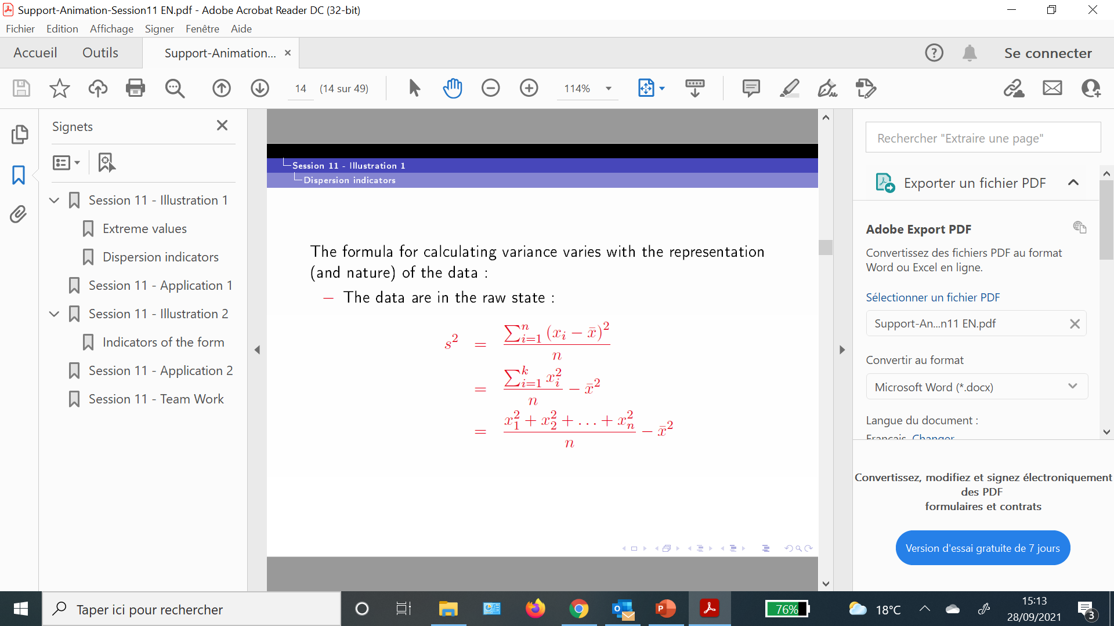
Dispersion Indicators –
Variance and Standard Deviation

Slide 11
Note

Slide 12
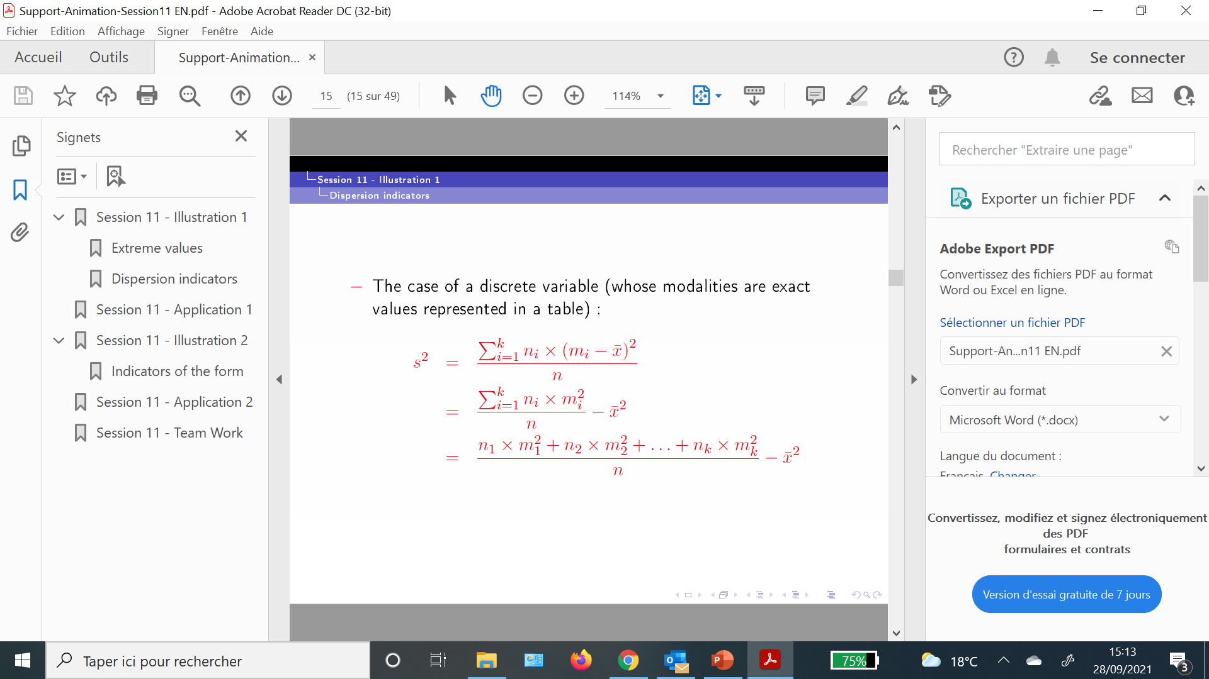
Dispersion Indicators –
Variance and Standard Deviation

Slide 13
Note

Slide 14

Dispersion Indicators –
Variance and Standard Deviation

Slide 15
Note

Slide 16
Examples – calculation of variance and standard deviation
Example 1 :
The data below represents the grades / scores of 10 students:
12, 10, 8, 8, 11, 11, 7, 14, 11, 12
Calculate the standard deviation.

Slide 17
Note

Slide 18
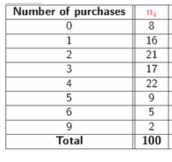
Examples – calculation of variance and standard deviation
Example 2 :
The data below represent the number of purchases (per week) of a product studied out of 100 French families
Calculate the standard deviation.

Slide 19
Note

Slide 20
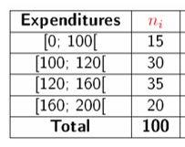
Examples – calculation of variance and standard deviation
Example 3 :
The data below represents the monthly expenses of 100 households for the purchase of a certain product
Calculate the standard deviation.n

Slide 21
Note

Slide 22
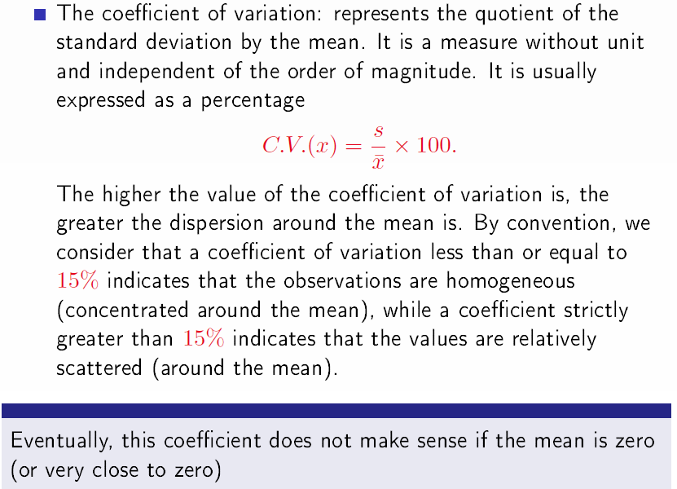
Dispersion Indicators –
The Coefficient of Variation

Slide 23
Note

Slide 24
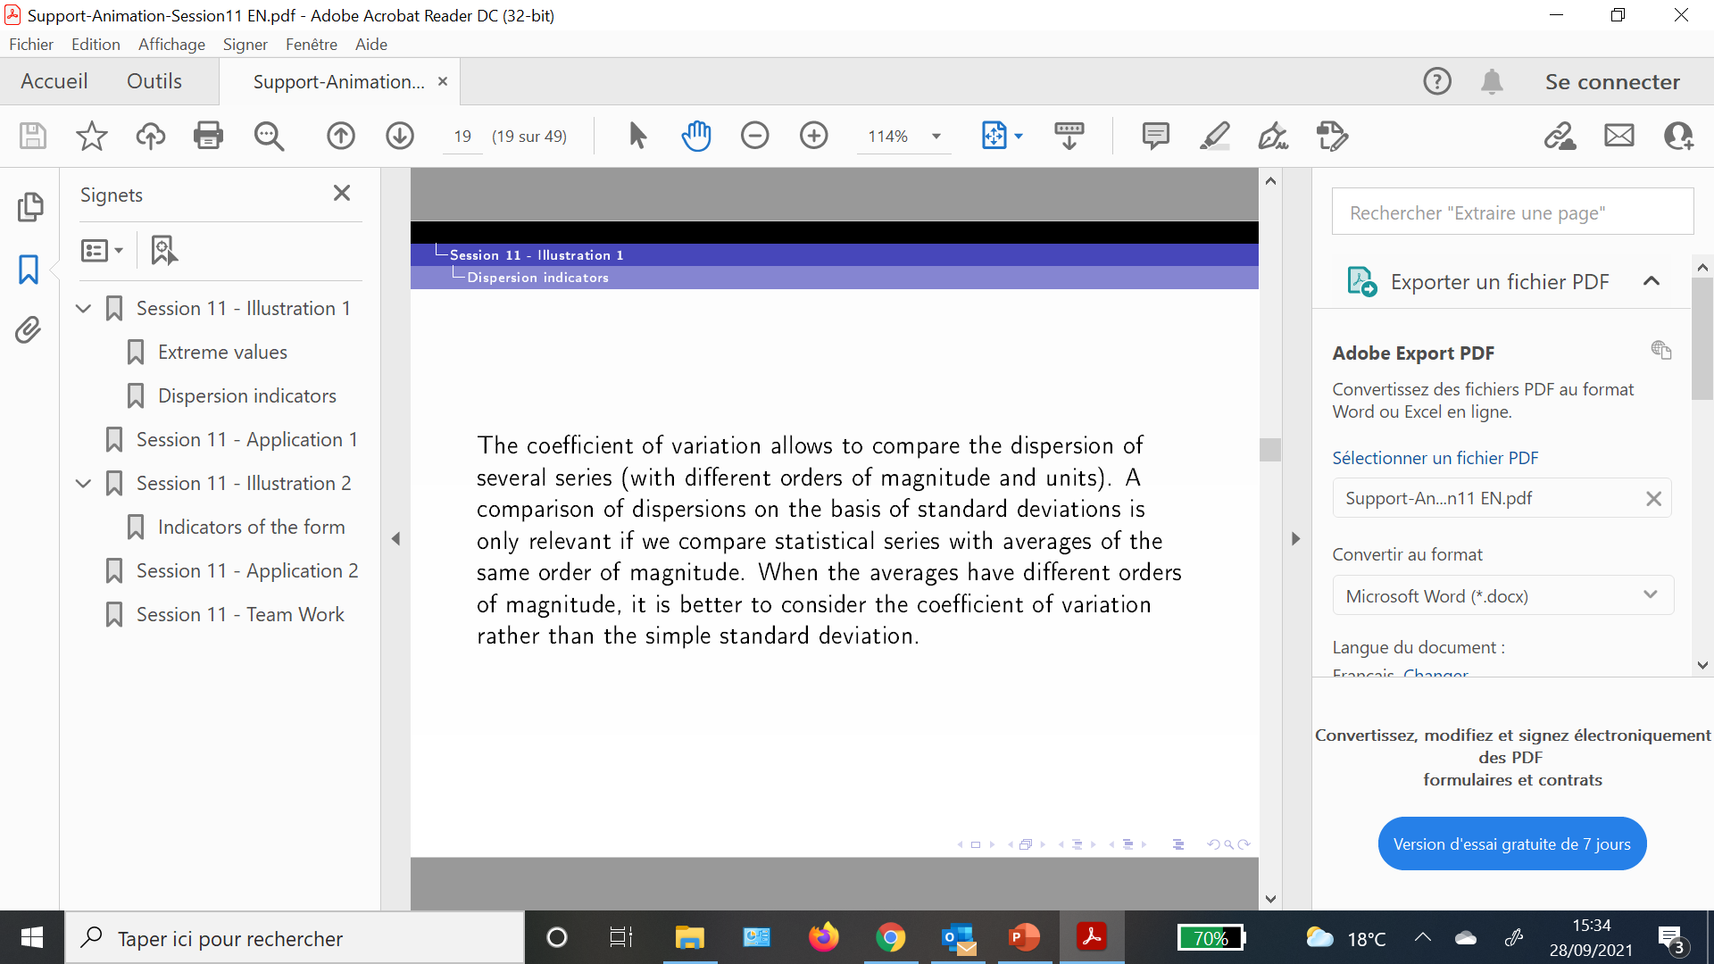
Dispersion Indicators – The Coefficient of Variation

Slide 25
Note

Slide 26
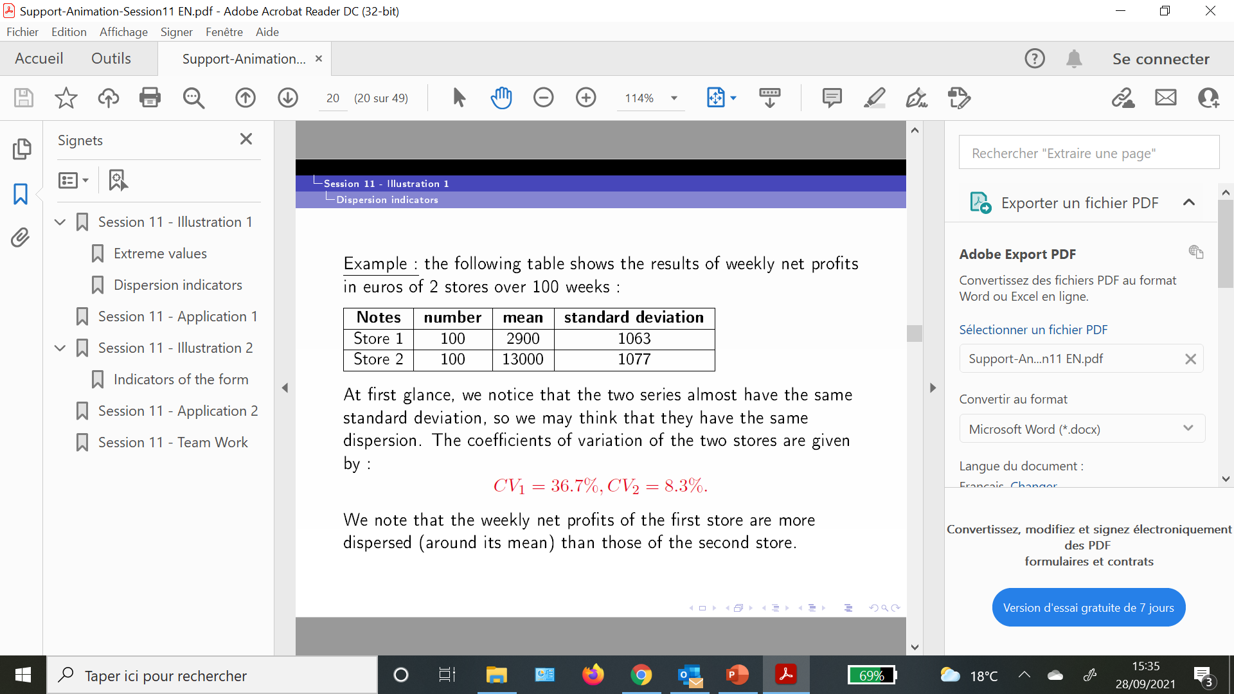
Dispersion Indicators – The Coefficient of Variation

Slide 27
Note

Slide 28
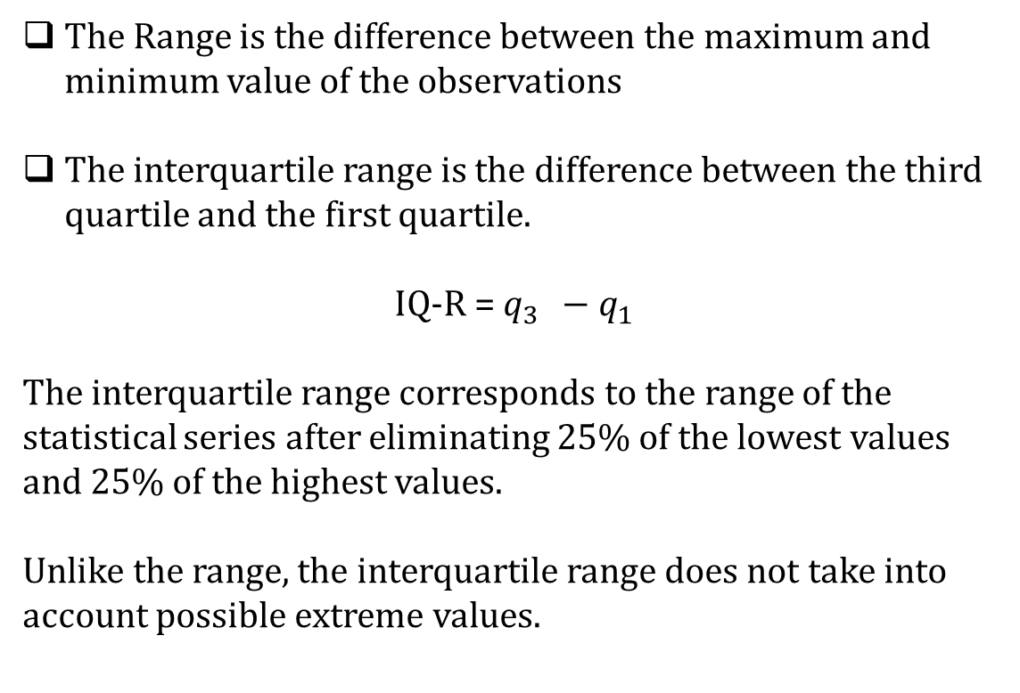
Dispersion Indicators –
The Range and The Interquartile Range
The Range is the difference between the maximum and minimum value of the observations
The interquartile range is the difference between the third quartile and the first quartile.
IQ-R = $q_{3 } −q_{1}$
The interquartile range corresponds to the range of the statistical series after eliminating 25% of the lowest values and 25% of the highest values.
Unlike the range, the interquartile range does not take into account possible extreme values.

Slide 29
Note

Slide 30
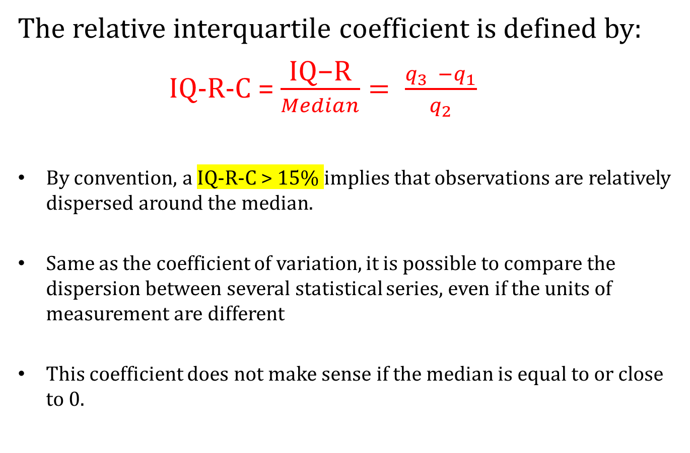
Dispersion Indicators –
The Relative Interquartile Coefficient
The relative interquartile coefficient is defined by:
IQ-R-C = $\frac{\text{IQ}\text{−}\text{R}}{Median}= \frac{q_{3 } −q_{1}}{q_{2}}$
By convention, a IQ-R-C > 15% implies that observations are relatively dispersed around the median.
Same as the coefficient of variation, it is possible to compare the dispersion between several statistical series, even if the units of measurement are different
This coefficient does not make sense if the median is equal to or close to 0.

Slide 31
Note

Slide 32
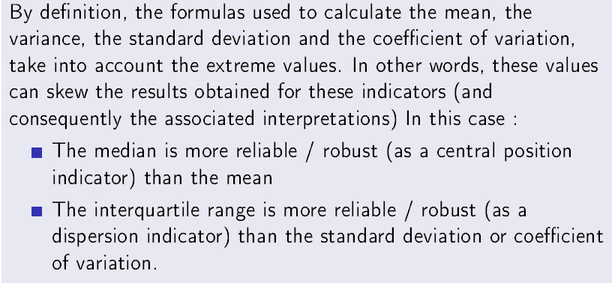
General remark

